Slide 1
Day 2: Part A Action planning and review

Slide 2
Agenda for today
Recap on yesterday’s learning
Review Module 2B
Stakeholder mapping
Microplanning
Macroplanning
Action planning
Implementation and review
Costing tool

Slide 3
Module 2B Micro and macro planning meetings
Session 2.0

Slide 4
Activity 2.1
Play video 2

Slide 5
Activity 2.2- Question and answer on planning meetings
What is your current experience of planning meetings for MAM?
What do you understand by the term microplanning?
Who should attend microplanning meetings? and why (relevance of stakeholders to the meeting)?
What do they understand by the term macroplanning meetings?
Who should attend macro planning meetings?

Slide 6
What is micro planning?
Promotes bottom- up planning for equitable sensitisation and distribution of medicines.
It brings together stakeholders from the LGA for context- specific planning.
It increases coverage as LGAs know their communities better and how best to implement MAM in the area.
Participants should include: The MoH, LNTD/ LGA team, representatives of CDCs/ CDAs, PWDs, Women Group, traditional leaders and migrant communities.
Invitation to participants should be sent at least two weeks ahead of the day with a reminder at least three days before the day.
Venue that is accessible and convenient for the intended number of participants should be selected.
Action template should be used to document details

Slide 7
What is macro planning?
This is another planning activity at the State level for MAM. It should be informed by the outcome of action planning at the LGA level. Similar to the micro planning, this activity should aggregate activities such as;
Community sensitization and advocacy
Medicines requisition and allocation
Supervision and monitoring etc
The key difference is that macro planning is wider than micro planning, hence the latter must be conducted across all LGAs scheduled to treat within the treatment cycle.

Slide 8
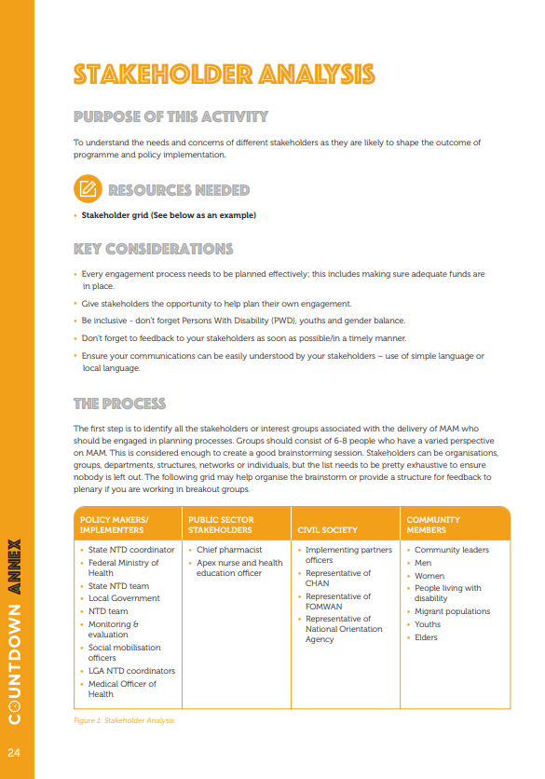
Who to invite to planning meetings: Stakeholder mapping
Work through stakeholder mapping exercise in the PGP

Slide 9
Module 3- Developing action plans
Session 3.0

Slide 10
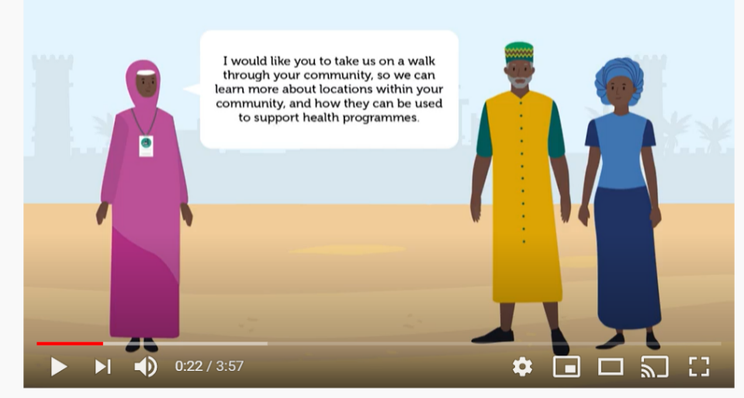
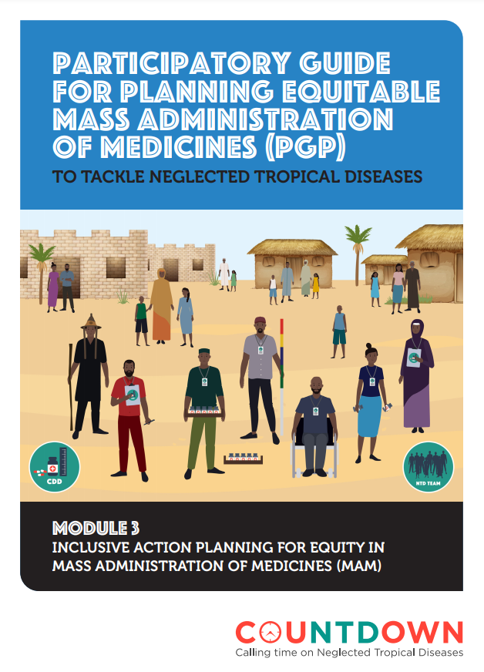
Introduction to Module Three:
Developing Action Planning
Play module three video
Discuss PGP module three (Page 10)
Question and answers

Slide 11
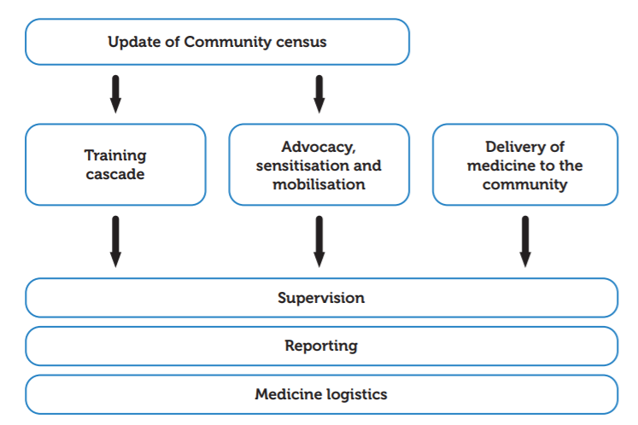
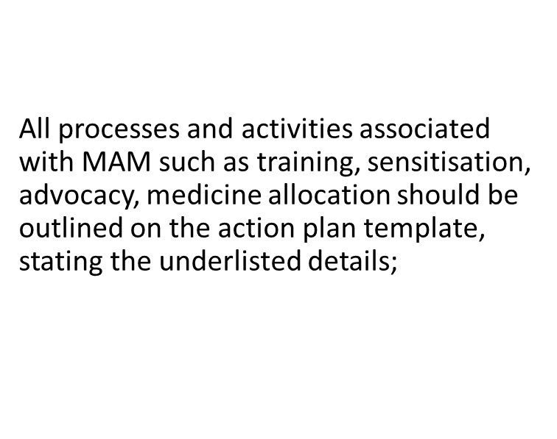
MAM as a process

Slide 12
Action planning
Action planning is often context- specific e.g either the plan is for rural, urban, migrant or border communities. Therefore, implementers should know that what works in community or LGA
Action planning should always consider equity and how best to reach everyone.
Action plans drawn on the template are not cast in stones; they can be amended based on emerging realities. However, any changes made must be updated on the template and copy shared with stakeholders involved using different mediums such as email, WhatsApp, hard copies etc.
Implementers can keep track of activities to ensure all activities are carried out as planned.
Participation of relevant stakeholders makes it easier to plan effectively and monitor equitable implementation.
Refer to the PGP document and video for additional guide on the two areas of planning.
Action planning should consider budget and resources available, as well as potential challenges within the context (like security)

Slide 13
Micro planning process
Action plans should include:
Proposed start and end dates
Roles/ persons assigned responsibilities
Resources required/ budget etc
Participants should discuss each item, agree and fill the corresponding column and rows.
Other details to capture may include hard- to- reach communities (Find example template on the next slide).
Final copy of the filled action plan should be printed and pasted at a strategic location where it is accessible by all in the LGA.

Slide 14
Micro planning template
**Welton Media, please add here the image of the microplanning template you’re working on within the PGP**

Slide 15
Template on hard- to- reach communities
See Page 9 of PGP Module 3

Slide 16
Filling out the macro planning template
Similar approach of filling the micro planning template may be employed here. However, note that the state level- macro planning is more elaborate because it contains plans of the LGAs.
Participants at this planning to include;
DPH,
SNTD and staff of the unit e.g logistics officer, data managers etc
Representatives of SACON
Civil Society Organisations
Representatives of UNICEF, WHO or/ and the funding organisation.

Slide 17
Activity 3.2- Action planning exercise
Read Module 3 of the PGP
You will see there are a range of actions for rural and urban contexts along the MAM pathway
Within small groups, Use the template provided and examples from PGP, complete 2-3 actions for each phase of MAM
Prepare to feedback to wider group with key learnings

Slide 18
Group presentations on action plans
Session 4.0

Slide 19
Action plan implementation and Review
Session 5.0

Slide 20
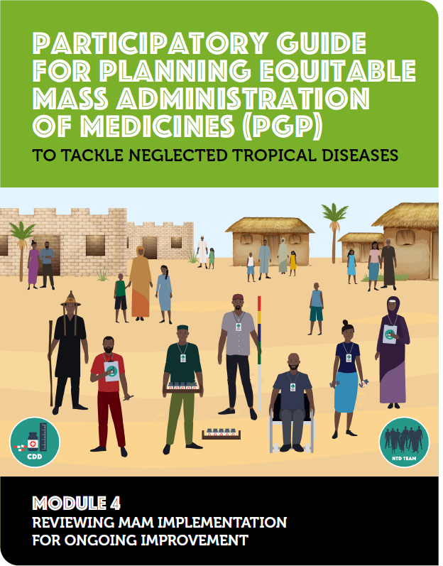
Module 4: Action Plan Implementation Review
Play module four video
Discuss PGP module four
Question and answers

Slide 21
Review of MAM process
Reviewing MAM is a cardinal part of the process to enable learning from the strength and weaknesses of previous cycles.
It is therefore important that the process is conducted across LGA and state after completion of each cycle. Below is an example of a review template to use.
IMPLEMENTATION PROCESS | SPECIFIC TASK IN THE IMPLEMENTATION PROCESS | WHAT WORKED WELL | WHAT DID NOT WORK WELL | AREAS OF IMPROVEMENT OR CHANGE FOR NEXT MAM ROUND
Sensitisation | NTD road walk along major roads in the town | Donation of vehicles and aprons by CDC in the LGA | No budget for fuelling of the donated vehicles. | Making budgetary provision for fuelling during next round of sensitisation.
Medicine distribution | Using mobile fixed locations like churches, mosques, townhalls for the distribution of medicines. | Meeting eligible populations in clusters made it possible for positive influence to make other persons willing to accept the medicines. | Where there was rejection by a single person, we had negative acceptability from others as well. | Move round with more posters and leaflets to sensitise the population more effectively.

Slide 22
Activity 5.2- Group review
What worked well? | What worked less well? | Areas needing improvement

Slide 23
Any questions?

Slide 24
Day 2: Part B:
Costing tool for advocacy and resource mobilisation

Slide 25
Work through the costing tool
Share the costing tool with relevant implementers
Discuss potential options for resource mobilisation
Develop a list of potential funders and the amount you wish to request based on the tool costings
Present to funders for resource mobilisation

Slide 26
Any questions?

